Slide 1

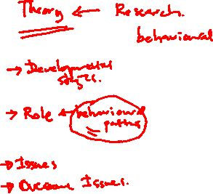
Teams for Teamwork
Professional Skills
Lecture 03

Slide 2
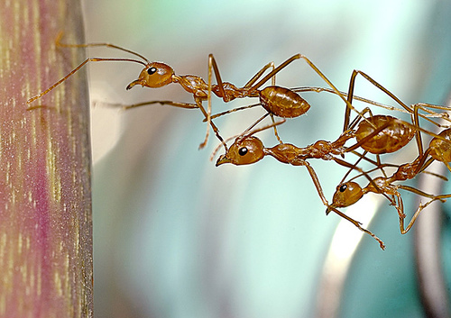
What is a team ?
“Two or more freely interacting people with shared norms, goals, and with a common identity“ (Kreitner & Kinicki, 2003)
“A team is a group of people working toward a common goal.”

Slide 3
A team can be..
Large – (20-30)
Ex: IT Department Lecturers, Senate
Small - (2-5)
Ex: Board of Directors, Surgeons of a surgery
Short Term
Ex: event committee
Long Term
Ex: Parliament standing committee for Public Relations

Slide 4
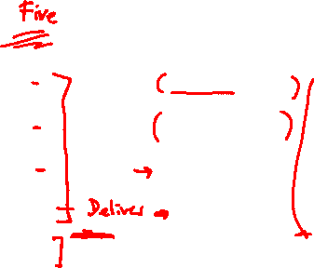
Team Development Stages
There are four stages to group development
Forming
Storming
Norming
Performing
Adjourning
- Dr. Bruce Tuckman

Slide 5
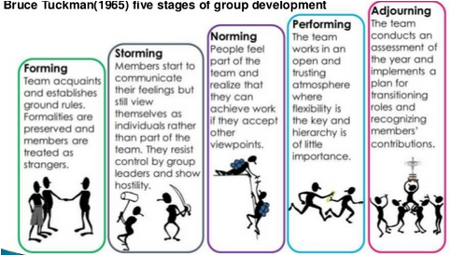
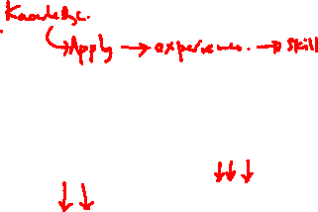
Team Development Stages

Slide 6
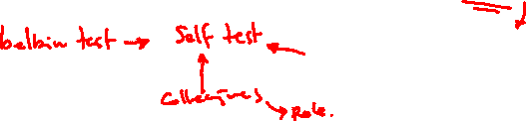
What is a Team Role?
A Team Role came to be defined as:
“A tendency to behave, contribute and interrelate with others in a particular way.”
-Dr Meredith Belbin

Slide 7
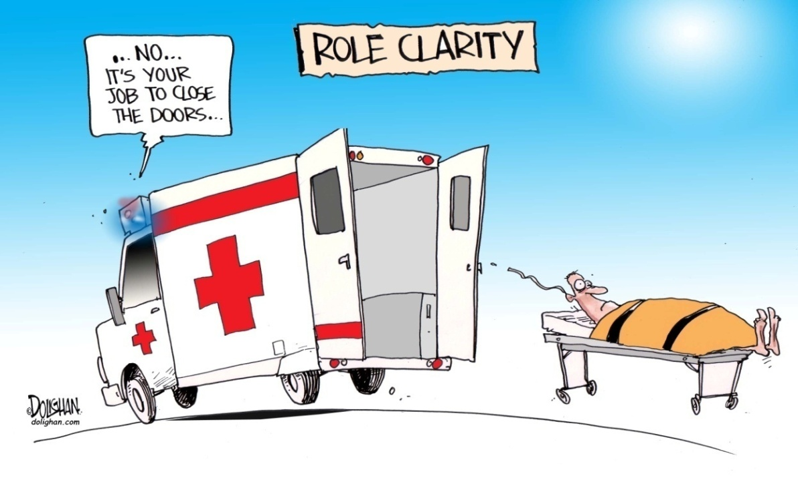

Role

Slide 8
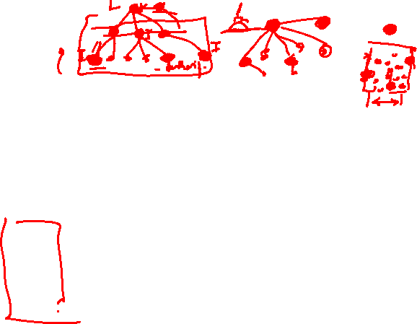
Role
Set of behaviors required or expected of the person occupying a certain position in a group.
There are two types of roles :
Formal Role - dictated by the structure of the organizations (coach, team captain).
Informal Role - evolve from the group's dynamics.
Role Acceptance - important to enhance a group’s structure.

Slide 9









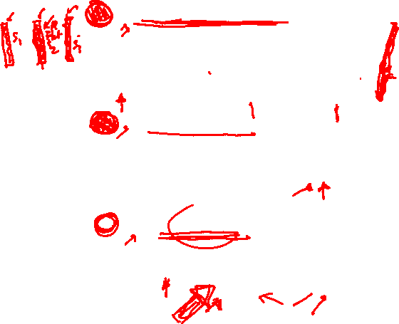
Belbin Team Role Theory
The nine team roles
Plant
Monitor Evaluator
Specialist
Coordinators
Resource Investigators
Team workers
Implementers
Shapers
Completer-Finishers
Thought Focused Roles
People Focused Roles
Action Focused Roles

Slide 10
Problems with Roles
Role Overload
Role Conflict
Role Ambiguity
Rigidity
Territoriality
Abdication
Human Nature

Slide 11
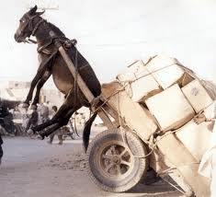
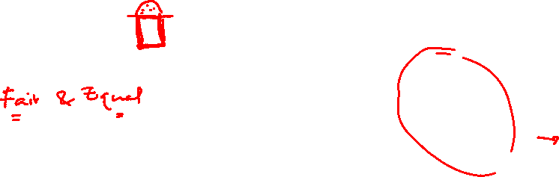
Problems with Roles
Role Overload :
This can leave the member exhausted, attempting to get more done in less time.
Stress builds and productivity falls.
Personal defeat can isolate the member from the group and shatter communication.

Slide 12
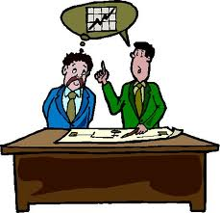
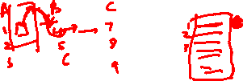
Problems with Roles
Role Conflict :
This is when the members of a group each have a different expectation of another's responsibilities.
This person will feel torn and unable to come to terms with the group identity, which can also occur when there is a moral or ethical dilemma with another of the group.

Slide 13
Problems with Roles
Role Ambiguity :
This is when a role is left too vague or undefined, and the individual does not know what is expected of them by the group.
Members experiencing role ambiguity find their self confidence drops and due to that efficiency slows to a crawl.
Without an identity relative to the other group members, an individual cannot perform and they will often isolate and shy away from the other group members.

Slide 14

Problems with the Role Concept
Rigidity:
Sometimes prevents flexibility, other potentials

Slide 15
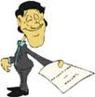
Problems with the Role Concept
Abdication:
Avoiding contributing within another’s role just because it is someone else’s responsibility

Slide 16
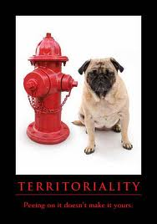
Problems with the Role Concept
Territoriality:
Reluctance to get contribution from others to the role assigned to someone, Guard his role/personal space

Slide 17

Problems with the Role Concept
Human nature:
The annoying habit of being unpredictable, straying from expected role and inconsistency in same role across the individuals

Slide 18
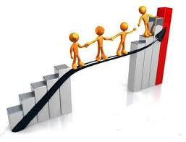
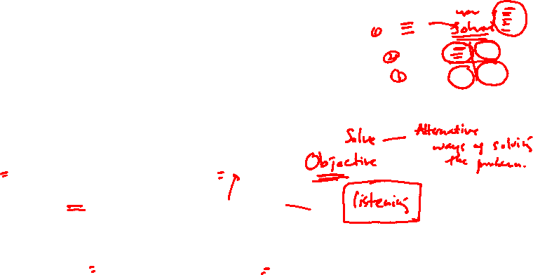
Handling the problems
Solid, unemotional discussion
Role re-delegation until responsibilities have settled comfortably on the correct person.
Self-evaluation and Personality testing can also aid in correct role placement and determination, such as :
Howard Gardner's multiple intelligences test (Carter, Bishop, & Kravits, , Key 2.1, Key 2.2).

Slide 19
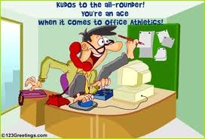
Alternative to the Role Concept
Empowering
Focus on Multiskilling people (all-rounders)

Slide 20
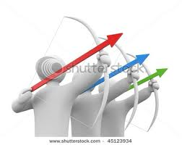


Successful team
Works together toward common goals
Perceive relevance of the group tasks
Mutual respect for members
Diversity of member skills/experience
Individual communication style

Slide 21

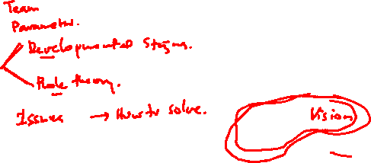
Conclusion
When people come together as a team, share a dream, and focus on reaching their goals together, there’s a very good chance they’ll accomplish what they set out to do!

